Slide 1



2022 Medicare Advantage Plan
LACERS
© 2021 United HealthCare Services, Inc. All Rights Reserved. Propriety information of UnitedHealth Group.
Do not distribute or reproduce without express permission of UnitedHealth Group.
Y0066_SPRJ62333_070121_M

Slide 2
Welcome
1
Original Medicare Basics
2
Plan Overview
3
Resources

Slide 3

UnitedHealthcare is here for you
Helping you make the most of your plan
Get the care you need when — and where — you need it
Whether it’s an appointment with a doctor online, a call with a nurse at 3 a.m. or taking care of a wellness visit from the comfort of your home, we make it easier to connect you with care so you can stay on top of your health — when, where and how you need it.
One-on-one help using your Medicare plan
At UnitedHealthcare, it’s not just customer service. It’s 1-on-1 support to help answer your questions and take the extra steps to understand your needs. It’s helping navigate your care during a health event. And it’s helping you get the most out of your plan, so you can be at your best health.
Renew by UnitedHealthcare®, our health and
wellness experience
Renew helps inspire you to take charge of your health and wellness every day by providing a wide variety of useful resources and activities, including brain games, healthy recipes, fitness activities, learning courses and more. All at no additional cost.*
*Renew by UnitedHealthcare is not available in all plans. Resources may vary.

Slide 4
UnitedHealthcare is here for you
Helping you make the most of your plan
Medicare Advantage’s largest provider network
UnitedHealthcare has Medicare Advantage’s largest provider network now with more doctors and specialists.*
Comprehensive drug coverage
When it comes to your prescription drug needs, it’s good to know that you’ll have one of the most comprehensive drug coverage programs available. And, you can have your prescriptions delivered straight to your door — it’s like having a drugstore at your fingertips.
America’s #1 Medicare plan provider
More people turn to UnitedHealthcare than any other company** when it’s time to choose their Medicare coverage. UnitedHealthcare is proud to have been serving the health care needs of people just like you for more than 40 years — and you can count on us to be here when you need us.
*Network size varies by plan and by market. Based on UnitedHealthcare's national provider network report, May 2021.
**Based on May 2021 CMS & NAIC enrollment data.

Slide 5
Original Medicare Basics

Slide 6
When are you eligible for Medicare?
You may be eligible for Original Medicare (Parts A and B) if:
    You’re 65 years old, or you’re under 65 and qualify on the basis of disability or other special situation
  AND
    You’re a U.S. citizen or a legal resident who has lived in the United States for at least 5 consecutive years
If you (or your spouse) have contributed payroll taxes to Medicare throughout your working life, you may be eligible for Medicare when you reach age 65 — regardless of your income or health status.

Slide 7
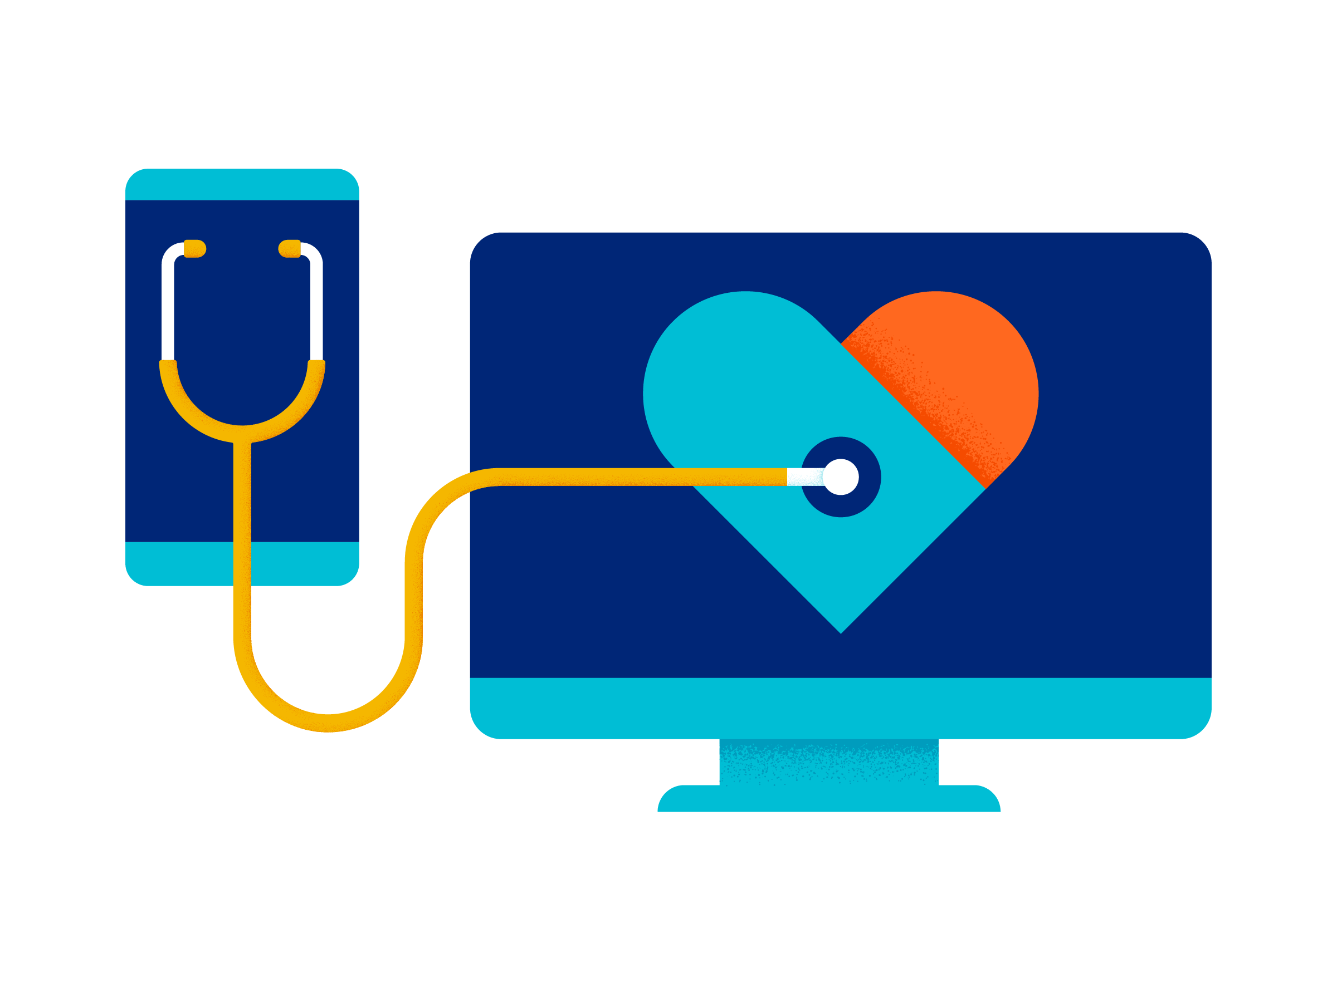
Why choose a Medicare Advantage Plan?
Medicare Advantage Plans provide all of the services found in original Medicare A and B such as hospital stays and skilled nursing care and doctor visits, labs, and preventative care
Additional benefits include prescription drug coverage and special programs and discounts rolled into a single plan
A single ID card to access all of your benefits

Slide 8
Plan Benefits, Programs and Features
UnitedHealthcare® Group Medicare Advantage (HMO)

Slide 9




Medicare Advantage HMO plan
This plan includes:
All the benefits of Part A
Hospital stays
Skilled nursing
Home health
Prescription drug coverage
Rich prescription drug coverage with full coverage in the gap
All the benefits of Part B
Doctor visits
Outpatient care
Screenings and shots
Lab tests
Additional benefits, programs and features
Beneficiary focused health & wellness programs
Hearing and Acupuncture and Chiropractic benefits

Slide 10
Your plan overview (HMO)
Coverage for visiting doctors, clinics and hospitals
Prescription drug coverage
Choose doctors and hospitals from an approved network

Slide 11

Your doctors (HMO)
This plan offers a large network of doctors, specialists and hospitals
Your doctor may already be part of our network. To find out, search our online Provider Directory at UHCRetiree.com or call UnitedHealthcare Customer Service 800-457-8506.

Slide 12
Medicare Advantage HMO Plan
 | You pay
Annual deductible | $0
Annual out-of-pocket maximum | $6,700

Slide 13
Medicare Advantage HMO Plan
Benefit coverage | In-network
Primary care provider (PCP) office visit | $15 copay
Specialist office visit | $15 copay
Urgent care | $15 copay (worldwide)
Emergency Room | $50 copay (worldwide)
Inpatient hospitalization | $0 copay per stay
Outpatient surgery | $0 copay
Medical virtual visits | $0 copay
Hearing Aid Allowance | $2,000 every 36 months when using the UnitedHealthcare Hearing Program

Slide 14
Preventive Services
Benefit coverage | In-Network
Annual physical and Wellness Visit | $0 copay
Immunizations | $0 copay
Breast and Colon cancer screenings | $0 copay
Medicare-covered chiropractic care | $15 copay
Acupuncture | $15 copay

Slide 15
Prescription benefits
Tier | Prescription drug type | Your costs
 |  | Retail (30-day supply) | Preferred Mail Order¹ (90-day supply)
Tier 1 | Preferred Generic All covered generic drugs | $10 copay | $20 copay
Tier 2 | Preferred Brand Many common brand-name drugs, called preferred brands | $20 copay | $40 copay
Tier 3 | Non-preferred Drug Non-preferred brand-name drugs. In addition, Part D-eligible compound medications are covered in Tier 3. | $50 copay | $100 copay
Tier 4 | Specialty Tier – (some limitations apply) Unique and/or very-high-cost brand-name drugs | $50 copay | $100 copay

Slide 16
Additional Programs and Resources

Slide 17









Take an active role in your health with Renew by UnitedHealthcare
®*
Renew by UnitedHealthcare is our health and wellness experience that helps empower you to take charge of your well-being every day. It provides a wide variety of useful resources and activities, including brain games, healthy recipes, learning courses, fitness activities and more. Plus, you may be eligible to earn rewards by completing certain health care activities such as your annual physical or wellness visit.**
Renew can help you take a more active role in your health and wellness through:
Renew magazine
Renew Rewards
Brain games
Workout videos
Learning courses
Interactive quizzes and tools
Health news, articles and videos
Health topic library
Recipe library
*Renew by UnitedHealthcare is not available in all plans. Resources my vary.
**Reward offerings will vary by member and Renew Rewards is not available in all plans with Renew by UnitedHealthcare.

Slide 18

¹
Introducing Renew Active® — the gold standard in Medicare fitness programs for the body and mind, at no additional cost to you
Renew Active includes:
A free membership at a gym near you
Access to our nationwide network of gyms
and fitness locations, including many
premium gyms — it is the largest of all
Medicare fitness programs*
An annual personalized fitness plan
Access to thousands of on-demand workout videos and live-streaming fitness classes
Social activities at local health and wellness classes and events
An online brain health program from
AARP® Staying Sharp®, including a brain
health assessment and exclusive content
for Renew Active members
Access to the online Fitbit® Community for Renew Active. This allows participation in fun, friendly step challenges with other health-minded members. Joining the community also provides access to Fitbit Premium™. To access Fitbit Premium, members must first join the online Fitbit Community for Renew Active. No Fitbit device is needed.
*Based on gym and fitness location network size.

Slide 19

Virtual Visits
With Virtual Visits, you’re able to live video chat with a doctor or behavioral health specialist from your computer, tablet or smartphone anytime, day or night²
Virtual Doctor Visits
You can ask questions, get a diagnosis or even get medication prescribed and have it sent to your pharmacy. All you need is a strong internet connection. Virtual Doctor Visits are good for minor health concerns including:
Allergies, bronchitis, cold/cough
Fever, seasonal flu, sore throat
Migraines/headaches, sinus problems, stomachaches
Virtual Behavioral Health Visits
Virtual Behavioral Health Visits may be best for:
Initial evaluation
Medication management
Addiction
Depression
Trauma and loss
Stress or anxiety
You can find a list of participating Virtual Visit providers by logging in to your member website.

Slide 20

UnitedHealthcare Hearing
Hear the moments that matter most
With UnitedHealthcare Hearing, you can receive a hearing exam and have access to a wide selection of name-brand and private-labeled custom-programmed hearing aids at significant savings. Plus, you’ll receive personalized care and follow-up support from experienced hearing providers, helping you to hear better and live life to the fullest.
Get access to the largest nationwide accredited network of more than 7,000
hearing providers*
Choose latest technology hearing aids from major manufacturers, including Phonak, Starkey®, Oticon, Signia, ReSound, Widex® and Unitron™
Receive hearing aids in person or delivered directly to your doorstep with virtual
follow-up care through Right2You, available only through UnitedHealthcare Hearing**
Save thousands of dollars, up to 50%–80% off standard industry prices, with
exclusive pricing^
*Please refer to your Summary of Benefits for details on your benefit coverage.
**Select products only.
^Based on suggested manufacturer pricing.

Slide 21

Diabetes testing and monitoring supplies
When you use one of the approved meters and corresponding strips, your cost-share for diabetes testing and monitoring supplies is a
$0 copay.
These supplies also include any brand of lancets, lancing device, glucose control solution (to test the accuracy of your meter) and replacement batteries for your meter.
To switch to one of the preferred brands, you may be required to get a new prescription from your doctor. A temporary supply of your current brand can be requested.
Your plan provides coverage for many of the OneTouch® and ACCU-CHEK® blood glucose testing strips and meters

Slide 22

Personal Emergency Response
System (PERS) ~ New for 2022!
With the Personal Emergency Response System, provided by Philips Lifeline, help is a button push away
Quick access to help in any situation whether an emergency or just need a helping hand
Helps give you confidence and independence

Slide 23

Trusted care at home when you need it
You are eligible for in-home, non-medical care through our national provider CareLinx
This may include grocery shopping, meal preparation, transportation, personal care, medication reminders and more.
Benefit includes: 12 hours a month
*Please refer to your Summary of Benefits for details on your benefit coverage.

Slide 24

Transportation program
Get to health-related appointments easier at no additional cost
This transportation program can help you get to your health care appointments — at no extra cost to you.
Routine Transportation
Up to 30 one-way trips or
15 round trips per year
Transportation provided to and from approved locations and must be medically related, such as doctors’ appointments and pharmacy trips
Transportation cannot be used for emergency-related situations

Slide 25
Post-Discharge Meal Delivery Benefit
Our post-discharge meal delivery program provides freshly-made meals to your home after you have been discharged from the hospital or skilled nursing facility, at no additional cost
The program provides up to 84 meals immediately following an inpatient hospital discharge or skilled nursing facility stay when referred by a UnitedHealthcare Advocate.

Slide 26
UHCRetiree.com
After you get your UnitedHealthcare
member ID card, sign up for your secure personal online account at UHCRetiree.com
After you sign up, you can:
Review benefit information and plan materials
Print a temporary member ID card and request a new one
Search for network doctors
Explore Renew by UnitedHealthcare, our member-only Health & Wellness experience
Sign up to get your Explanation of Benefits online
Follow these easy steps to sign up for your online account:
Visit the website and click
on the “Sign In/Register” button and then click
“Register Now”
Enter your information (first and last name, date of birth, ZIP code, UnitedHealthcare member ID number) and
click “Continue”
Create your username and password, enter your email address, and click “Create
my ID”
For security purposes, you will need to verify your account by email, call or text

Slide 27
Thank You
We look forward to welcoming you to our Medicare family

